Slide 1
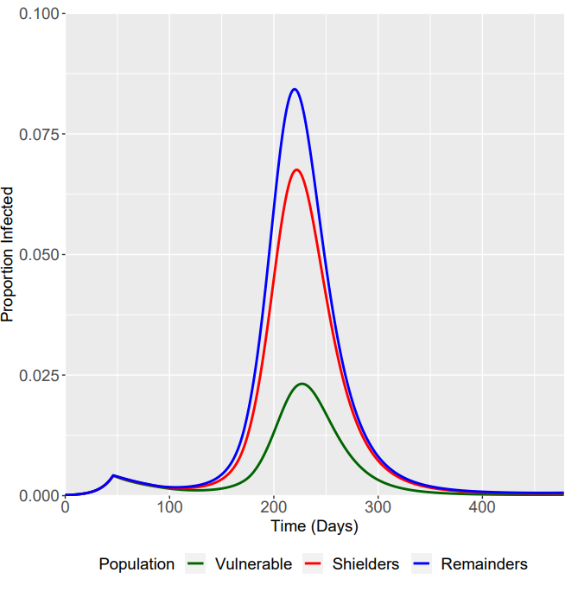
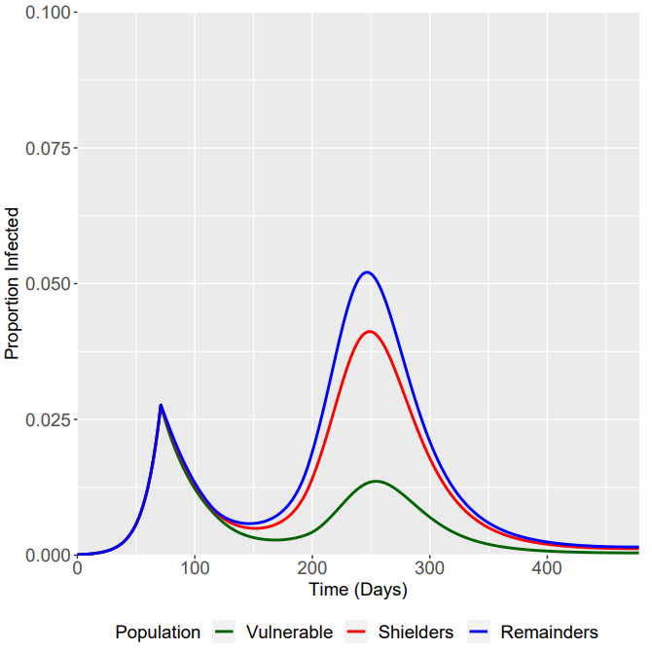
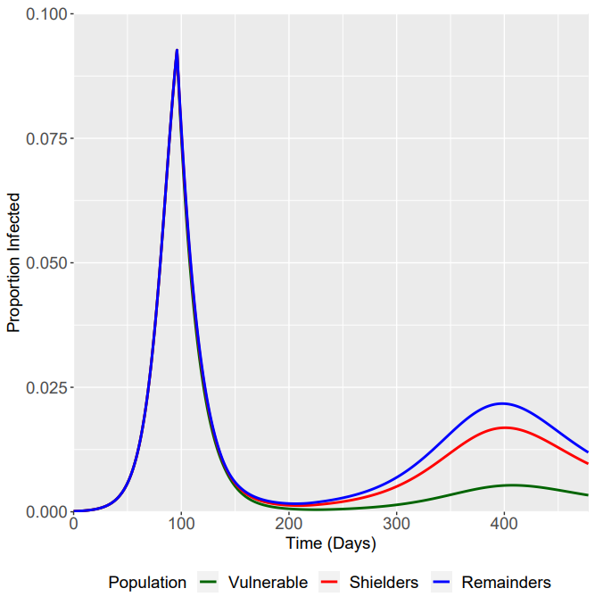
Trigger Point (-/+ 25 Days)
Trigger Point: 46 Days
Trigger Point: 71 Days
Where R_{tot}(t+7) = 0.06
Trigger Point: 96 Days

Slide 2
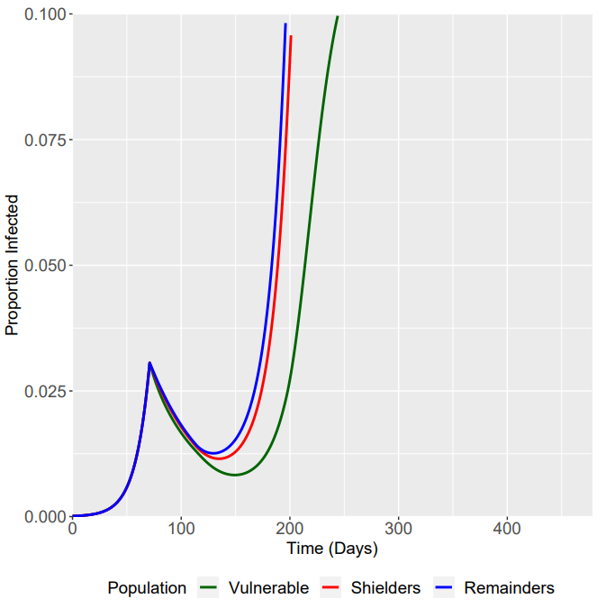
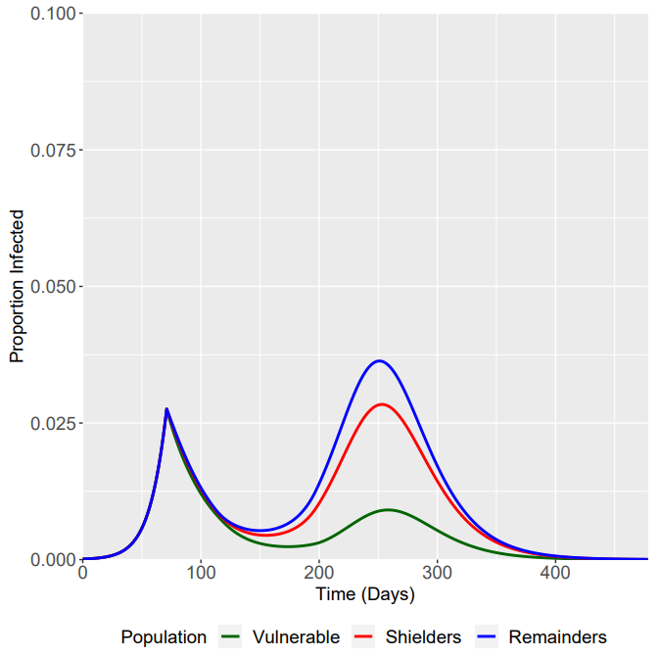
SIS/SIRS/SIR
SIS
SIRS
SIR

Slide 3
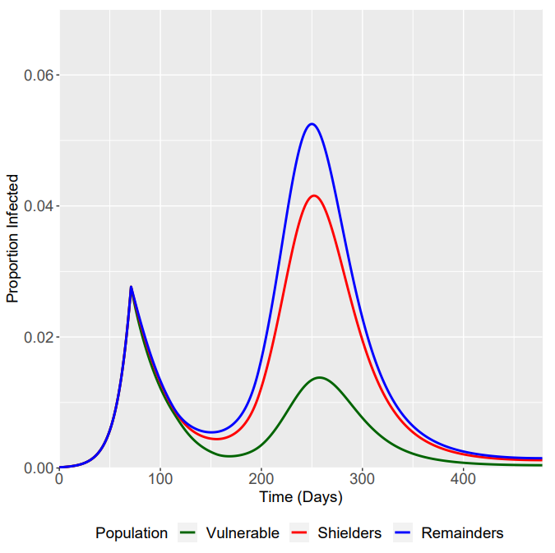
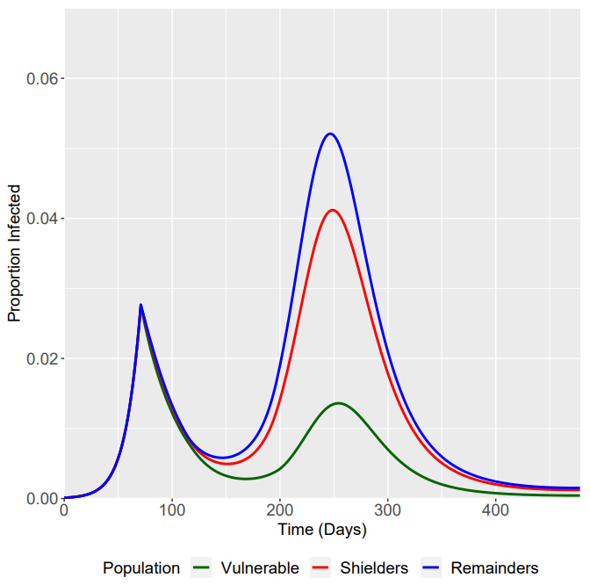
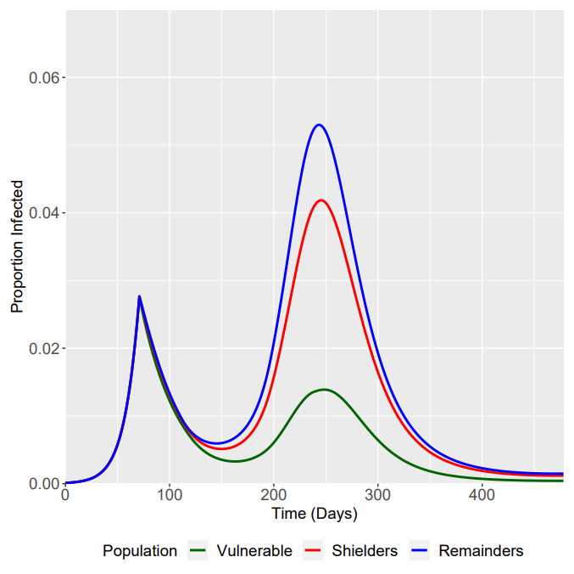
β₁/β₄ Intervention Ramp Up and Ramp Down
β₂/β₃ - 12 Weeks Ramp Up
β₁/β₄ - 6 Weeks Ramp Down
β₂/β₃ - 12 Weeks Ramp Up
β₁/β₄ - 12 Weeks Ramp Down
β₂/β₃ - 12 Weeks Ramp Up
β₁/β₄ - 18 Weeks Ramp Down

Slide 4
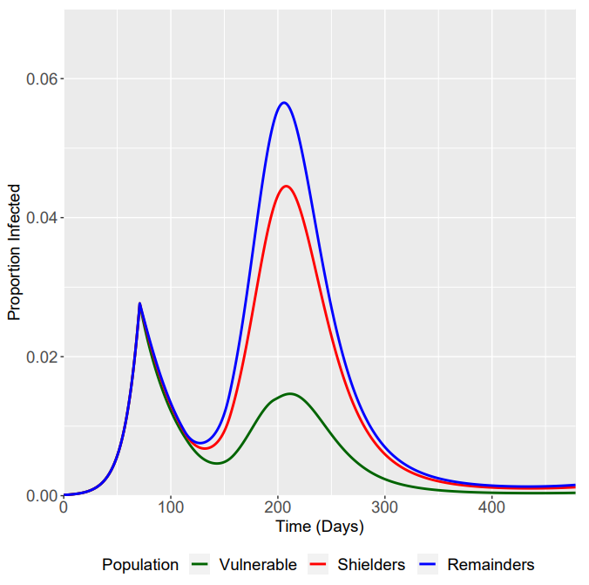
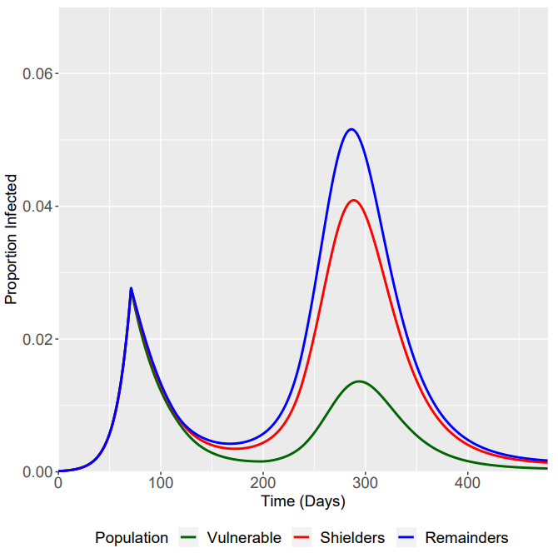
β₂/β₃ Intervention Ramp Up and Ramp Down
β₂/β₃ - 6 Weeks Ramp Up
β₁/β₄ - 12 Weeks Ramp Down
β₂/β₃ - 12 Weeks Ramp Up
β₁/β₄ - 12 Weeks Ramp Down
β₂/β₃ - 18 Weeks Ramp Up
β₁/β₄ - 12 Weeks Ramp Down

Slide 5
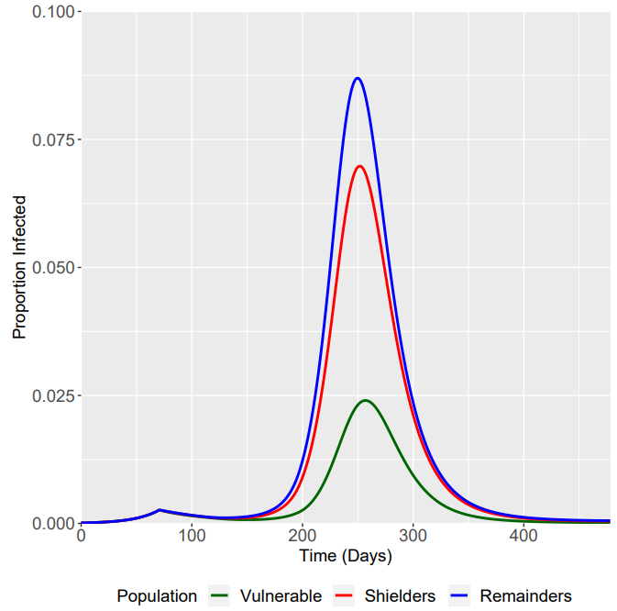
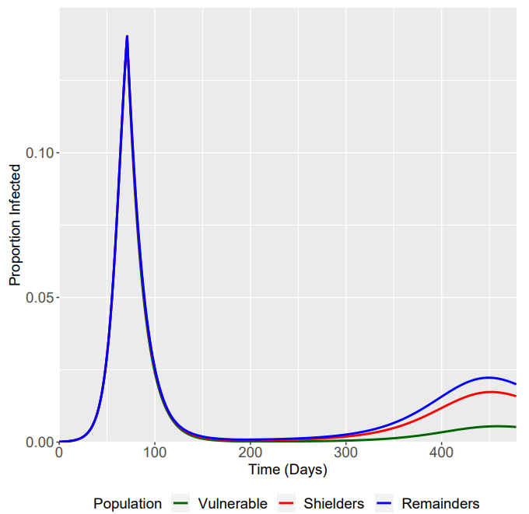
Phase 1 R0 +/- 0.3
R0 = 1.4
R0 = 1.7
R0 = 2.0
Note rescaled y-acis

Slide 6
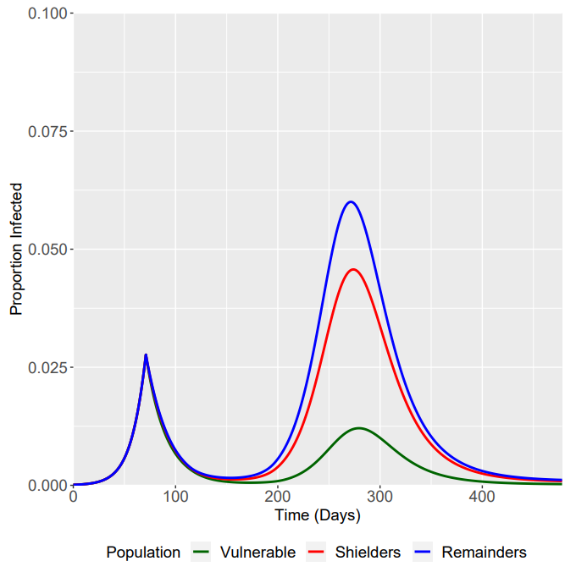
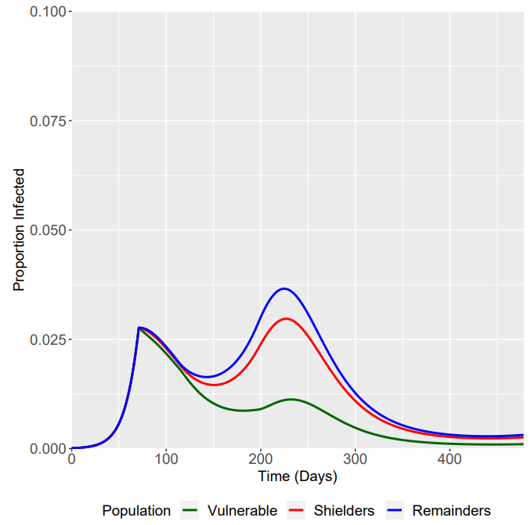
Phase 2 R0 +/- 0.2
R0 = 0.6/0.7
R0 = 0.8/0.9
R0 = 1.0/1.1

Slide 7
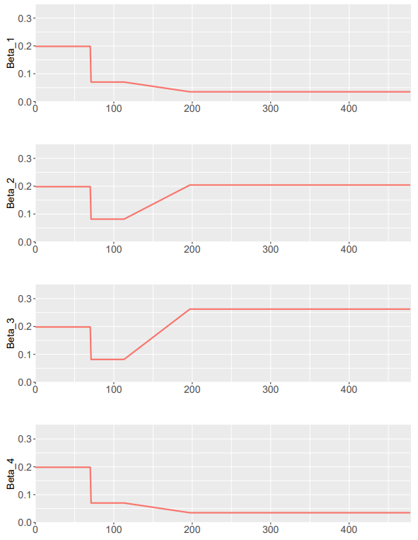
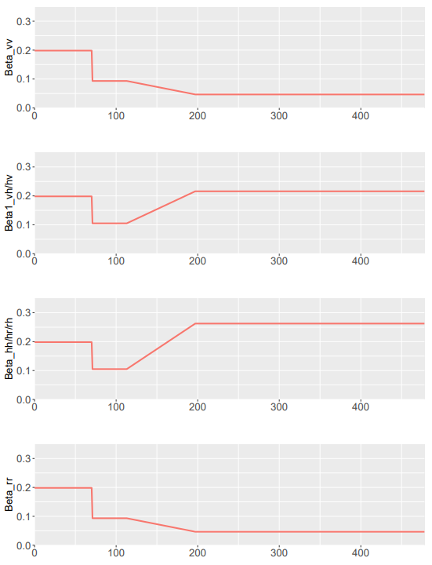
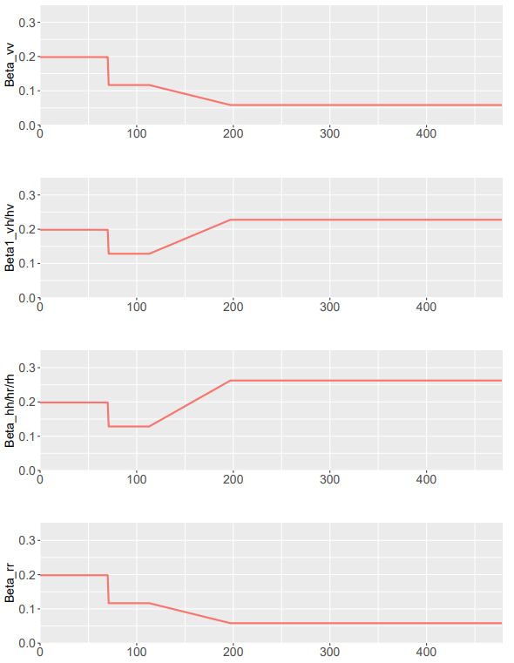
Beta Plots - Phase 2 R0 =/- 0.2
R0 = 0.6/0.7
R0 = 0.8/0.9
R0 = 1.0/1.1

Slide 8
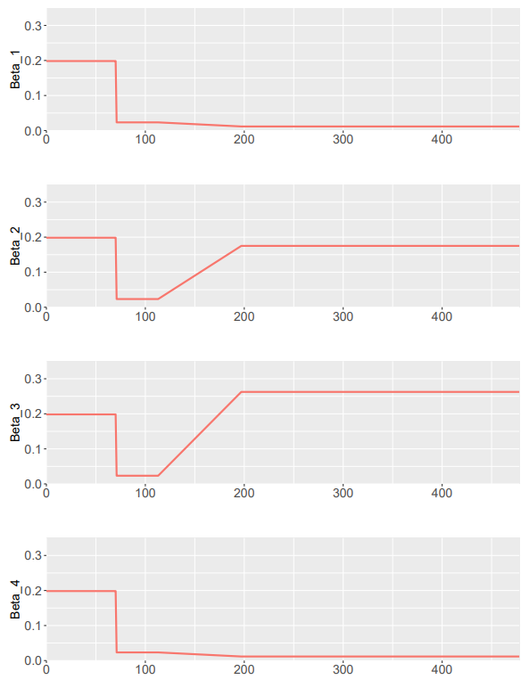
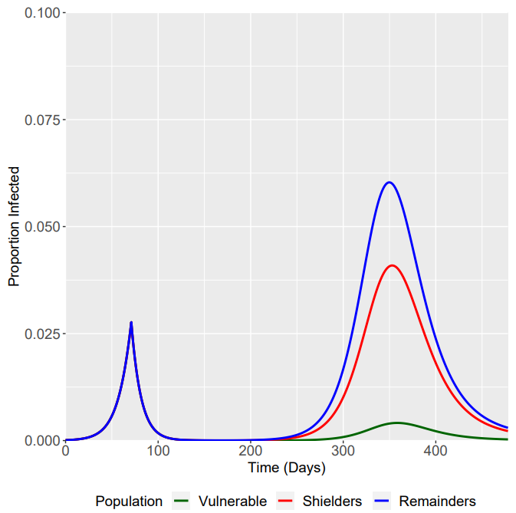
Phase 2 R0 = 0.2

